Slide 1

Development Across the Life Span
Eighth Edition
Chapter 13
Physical and Cognitive Development in Early Adulthood
Slides in this presentation contain hyperlinks. JAWS users should be able to get a list of links by using INSERT+F7
Copyright © 2017, 2014, 2011 Pearson Education, Inc. All Rights Reserved
Notes:
If this PowerPoint presentation contains mathematical equations, you may need to check that your computer has the following installed:
1) MathType Plugin
2) Math Player (free versions available)
3) NVDA Reader (free versions available)

Slide 2
Learning Objectives (1 of 3)
13.1 Describe how the body develops and stays healthy during early adulthood.
13.2 Explain why a healthy diet is particularly important in early adulthood.
13.3 Describe the challenges people with physical disabilities face in early adulthood.
13.4 Summarize the effects of stress and what can be done about it.

Slide 3
Learning Objectives (2 of 3)
13.5 Describe how cognitive development continues in young adulthood.
13.6 Compare and contrast Perry’s and Schaie’s approaches to cognitive development in young adulthood.
13.7 Explain how intelligence is defined today and how life events cause cognitive growth in young adults.

Slide 4
Learning Objectives (3 of 3)
13.8 Describe who attends college today and how the college population is changing.
13.9 Summarize the difficulties students face as they enter college.
13.10 Describe how gender effects the treatment of college students gender differences in college enrollment and academic performance.
13.11 Summarize why students drop out of college.

Slide 5
Physical Development
13.1 Describe how the body develops and stays healthy during early adulthood.
13.2 Explain why a healthy diet is particularly important in early adulthood.
13.3 Describe the challenges people with physical disabilities face in early adulthood.
13.4 Summarize the effects of stress and what can be done about it.

Slide 6
Physical Development and the Senses
An age of peak physical capabilities
Brain reaches maximum size and weight
Grey matter continues to be pruned and myelination increases
Senses are at their peak
Most professional athletes are at their peak during early adulthood
Notes:
In most respects physical development and maturation are complete by early adulthood.
Full height, proportional limbs, tend to be healthy, vigorous, energetic
Most people are at the peak of their physical capabilities.
The brain continues to grow in both size and weight, reaching its maximum in early adulthood.
Brain wave patterns show changes (more mature patterns).
The senses are as sharp as they will ever be.
No significant deterioration in vision (until the 40’s)
Hearing is at its peak
Taste, smell, sensitivity to touch good
Most professional athletes are at their peak during early adulthood.
Psychomotor abilities (eye-hand coordination, etc.)

Slide 7
Physical Fitness
Superior physical capabilities require regular exercise
and proper diet
Less than 10 percent of Americans exercise enough to keep themselves in good physical shape
Some exercise is better than no exercise; even moderate amounts can confer benefits
Notes:
The superior physical capabilities common to early adulthood don't come naturally; exercise and diet are required to reach full physical potential
Although exercise is talked about a lot in the U.S., no more than 10% of Americans exercise enough to keep themselves in good physical shape.
Less than 20% participate in moderate exercise on a regular basis
Exercise is largely an upper- and middle-class phenomenon
People of low socioeconomic status (SES) often lack the time or money to participate
People in general do not exercise enough!
The conspicuousness of exercise in the U.S. is misleading!
Less than 10% of Americans exercise sufficiently to keep them in shape
Less than a quarter engage in even moderate regular exercise

Slide 8
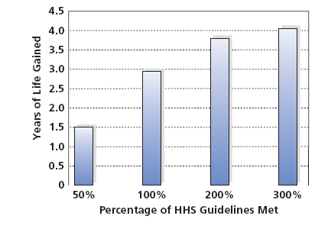
Figure 13-1 The Result of Fitness:
Longevity
The greater the fitness level, as measured by adherence to the Health and Human Services (H H S) guidelines met, the higher the gains in life expectancy due to physical activity.
Source: http://www.nih.gov/news/health/nov2012/nci-06.htm. November 6, 2012, 5 p.m. N I H study finds leisure-time physical activity extends life expectancy as much as 4.5 years. National Cancer Institute Press Release 11/16/12.

Slide 9
Health
Leading causes of death among young adults
(ages 25 to 34) are:
Accidents
AIDS
Cancer
Heart disease
Suicide
Murder
Gender and S E S differences
Notes:
At age 35, this reverses and illness and disease become more likely causes (for the 1st time since infancy).
Men are more apt to die from accidents than women.
African Americans have twice the death rate of Caucasians.
Murder rate in the U.S. is significantly higher than in any other developed country. U.S rate = 21.9 per 100,000 men; Japanese rate = 0.5 murders per 100,000 men
Murder is the fifth most frequent cause of death for young White Americans (1 in 131 chance in lifetime)
Murder is the most frequent cause of death for African Americans (1 in 21 chance in lifetime)
In some areas of the country, a young black male has a higher probability of being murdered than a soldier in the Vietnam War had of being killed!
African American male: 1 in 21 chance of being murdered in his lifetime
European American male: 1 in 131 chance

Slide 10
Secondary Aging
Lifestyle decisions, including the use - or abuse - of alcohol, tobacco, or drugs, or engaging in unprotected sex, can hasten secondary aging
This can also increase a young adult’s risk of dying
Notes:
Secondary aging, physical declines brought about by environmental factors or an individual's behavioral choices.

Slide 11

Figure 13-2 Tracking Murder
The murder rate is far higher in the United States than in many other developed countries. What features of U.S. society contribute to this state of affairs?
(Source: Based on U N O D C, 2013.)
Notes:
Another major cause of death for men in this age group is violence, particularly in the United States. The murder rate is significantly higher in the United States than in any other developed country.
Murder rates also depend significantly on racial factors. Although murder is the fifth most frequent cause of death for young adult white Americans, it is the most likely cause of death for African Americans, and it is a significant factor for Hispanic Americans.

Slide 12
Eating, Nutrition, and Obesity
Most young adults know which foods are healthy, but ignore good nutritional practices
Physical growth begins to decline
Calorie reduction is necessary
Notes:
Young adults will put on weight if they do not eat sensibly.
31% of the adult population is classified as overweight.
7% of men and 10% of women between the ages of 20 and 25 are obese.
The rate of obesity in the U.S. is increasing.
Genetic factors may lead people to become obese.
Environmental and social factors also produce obesity.
Obese people may have a higher WEIGHT SET POINT, the particular level the body strives to maintain.
Most people who diet eventually gain back the weight

Slide 13
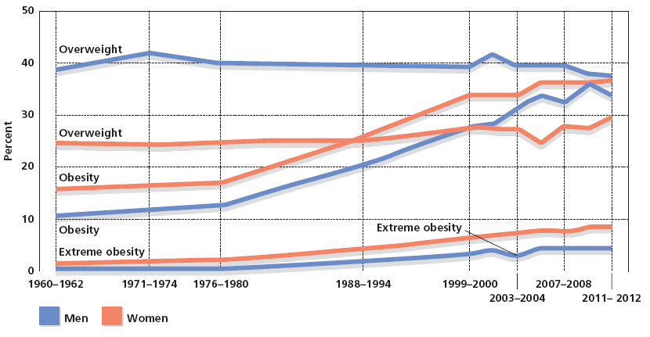
Figure 13-3 Obesity on the Rise
The murder rate is far higher in the United States than in many other developed countries. What features of U.S. society contribute to this state of affairs?
(Source: Based on U N O D C, 2013.)
Notes:
In spite of greater awareness of the importance of good nutrition, the percentage of adults with weight problems in the United States has risen dramatically over the past few decades. Why do you think this rise has occurred? (Source: Centers for Disease Control and Prevention, 2010.)
Weight control is a difficult, and often losing, battle for many young adults.
Most people who diet ultimately regain the weight they have lost, and they become involved in a see-saw cycle of weight gain and loss.
Some obesity experts now argue that the rate of dieting failure is so great that people may want to avoid dieting altogether.
If people eat the foods they really want in moderation, they may be able to avoid the binge eating that often occurs when diets fail.
Even though obese people may never reach their desired weight, they may, according to this reasoning, ultimately control their weight more effectively.

Slide 14
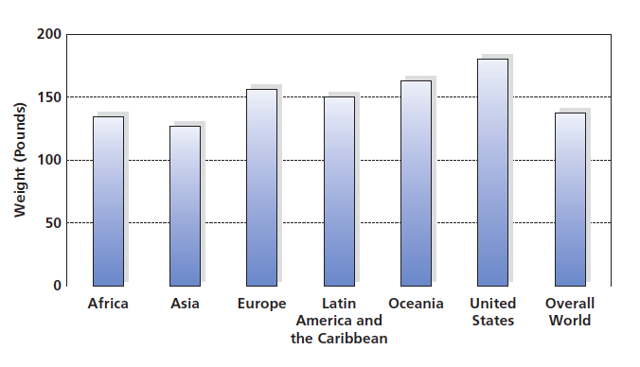
Figure 13-4 First in Obesity
Obesity is particularly prevalent in the United States. The world average weight for adults is 137 pounds; in the United States, the average is 180 (Walpole, 2012).

Slide 15
Physical Disabilities: Coping with Physical Challenge
Over 50 million Americans are physically challenged
  Fewer than 10 percent of people with major handicaps have finished high school
Fewer than 25 percent of disabled men and 15 percent of disabled women work full time
  Adults with handicaps are often unemployed, or stuck in routine, low-paying jobs
Notes:
Some 50+ million Americans are physically challenged - or disabled - a condition that substantially limits a major life activity such as walking or vision.
Fewer than 10% of people with major handicaps have finished high school.
Fewer than 25% of disabled men and 15% of disabled women work full time.
Adults with handicaps are often unemployed, or stuck in routine, low-paying jobs.

Slide 16
Barriers to Fair Treatment: Physical and Social
Despite the Americans with Disabilities Act (1990), many older buildings are inaccessible to wheelchairs
Prejudice and discrimination
  Pity, avoidance
  Treating adults as children
  Seeing the disabled person as a category rather than as an individual
Notes:
Discrimination and prejudice are barriers and affect the way that people with disabilities view themselves (their cognitive development!).
Despite the Americans with Disabilities Act (1990), many older buildings are inaccessible to wheelchairs.
Prejudice and discrimination affect the way disabled people think of themselves.
Pity, avoidance
Treating adults as children
Seeing disabled person as a category rather than an individual

Slide 17
Stress and Coping
Stress: Response to events that threaten or challenge an individual
Both pleasant events and unpleasant events can be stressful
Long-term, continuous exposure may result in a reduction of body’s ability to deal with stress
Notes:
Lives are filled with events and circumstances known as stressors, that cause threats to well-being.
Stressors can be both pleasant events and unpleasant events (weddings, winning awards, exams, arguments).
Long-term, continuous exposure to stressors may result in reduction of body’s ability to deal with stress.
People become more susceptible to diseases as their ability to fight off germs declines.

Slide 18
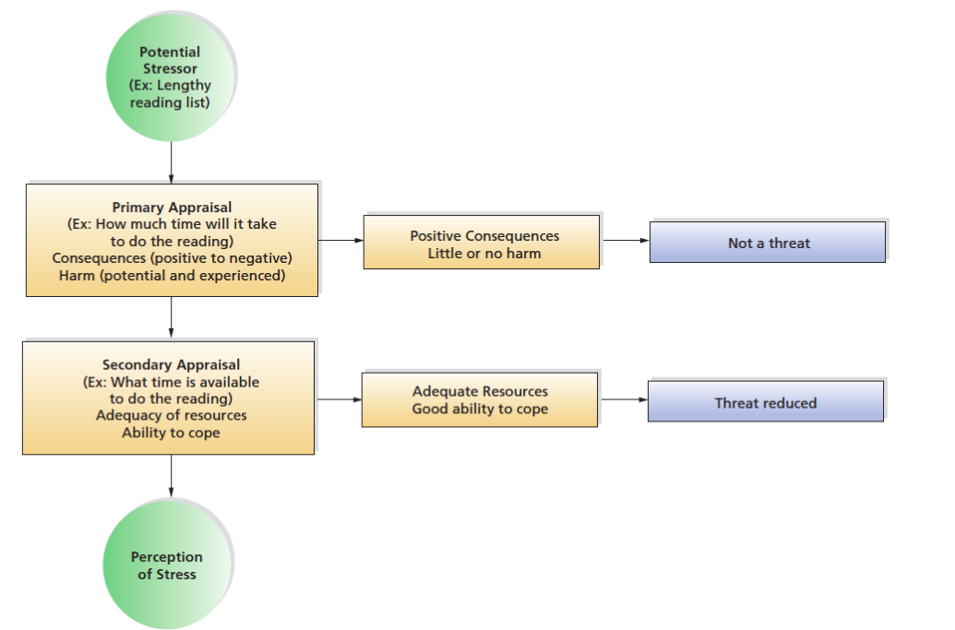
Figure 13-5 Steps in the Perception of Stress
The way we appraise a potential stressor determines whether we will experience stress.
(Source: Based on Kaplan, Sallis, & Patterson, 1993.)

Slide 19
The Origins of Stress
Negative emotions
Uncontrollable or unpredictable situations
Ambiguous and confusing situations
Simultaneous tasks demands
Notes:
Events and circumstances that produce negative emotions are more likely to produce stress.
Situations that are uncontrollable or unpredictable are more likely to produce stress.
Events and circumstances that are ambiguous and confusing produce more stress.
People who must accomplish simultaneously many tasks are more likely to experience stress.
Stress Quiz in text (Table 13-1)

Slide 20
The Consequences of Stress
Stress affects people in a number of ways
Increase the risk of becoming ill
Produce illness
Increase the difficulty of recovering from illness
Reduce the ability to cope with future stress
Notes:
Stress may lead to PSYCHOSOMATIC DISORDERS, medical problems caused by interaction of psychological, emotional, and physical difficulties.
Some young adults are better than others at COPING, the effort to reduce, or tolerate threats that lead to stress.

Slide 21
Coping with Stress
Problem-focused coping
Emotion-focused coping
Social support coping
Defensive coping
Notes:
Problem-focused coping is attempt to manage a stressful problem or situation by directly changing situation to make it less stressful.
Emotion-focused coping involves conscious regulation of emotion.
Coping is also aided by presence of social support, assistance and comfort supplied by others.
Defense coping involves unconscious strategies that distort or deny true nature of the situation.

Slide 22
Coping with Stress: General Guidelines
Seek control over the situation producing the stress
Redefine “threat” as “challenge”
Find social support
Use relaxation techniques
Try to maintain a healthy lifestyle
Remember - a life without any stress at all would be a dull one
Notes:
Seek control over the situation producing the stress. Putting yourself in charge of a situation that is producing stress can take you a long way toward coping with it. For example, if you are feeling stress about an upcoming test, do something about it—such as starting to study.
Redefine “threat” as “challenge.” Changing the definition of a situation can make it seem less threatening. “Look for the silver lining” is not bad advice. For example, if you’re fired, look at it as an opportunity to get a new, and potentially better, job.
Find social support. Almost any difficulty can be faced more easily with the help of others. Friends, family members, and even telephone hot lines staffed by trained counselors can provide significant support. (For help in identifying appropriate hot lines, the U.S. Public Health Service maintains a “master” toll-free number that can provide phone numbers and addresses of many national groups. Call 800-336-4794.)
Use relaxation techniques. Reducing the physiological arousal brought about by stress can be a particularly effective way of coping with stress. A variety of techniques that produce relaxation, such as transcendental meditation, Zen and yoga, progressive muscle relaxation, and even hypnosis, have been shown to be effective in reducing stress.

Slide 23
Hardiness, Resilience, and Coping
Hardiness
  Personality characteristic associated with lower rate of stress-related illness
Resilience
  Ability to withstand, overcome, and thrive following profound adversity
Notes:
Hardy individuals are take-charge people who revel in life's challenges. People who are high in hardiness are more resistant to stress-related illness than those who show less hardiness. Hardy people react to potentially threatening stressors with optimism, feeling that they can respond effectively. By turning threatening situations into challenging ones, they are less apt to experience high levels of stress.
Resilient young adults tend to be easy-going, good-natured, and have good social and communication skills. They are independent, feeling that they can shape their own fate and are not dependent on others or luck. They work with what they have and make the best of whatever situation in which they find themselves.

Slide 24
Cognitive Development
13.5 Describe how cognitive development continues in young adulthood.
13.6 Compare and contrast Perry’s and Schaie’s approaches to cognitive development in young adulthood.
13.7 Explain how intelligence is defined today and how life events cause cognitive growth in young adults.

Slide 25
Intellectual Growth in Early Adulthood: Postformal Thought
Moving Beyond Piaget
Adult predicaments are sometimes solved by relativistic thinking rather than pure logic
Postformal thought acknowledges that the world sometimes lacks purely right and wrong solutions, so adults must draw upon prior experiences to solve problems
Postformal thought encompasses dialectical thinking
Facilitates shifting back and forth between an abstract, ideal solution, and real-world constraints that might prevent the solution from being successfully implemented
Notes:
Developmentalist Giesela Labouvie-Vief suggests that nature of thinking changes qualitatively during early adulthood.
Adults exhibit POSTFORMAL THOUGHT, thinking that goes beyond Piaget's formal operations.
Adult predicaments are sometimes solved by relativistic thinking rather than pure logic.
Postformal thought acknowledges that world sometimes lacks purely right and wrong solutions and adults must draw upon prior experiences to solve problems.

Slide 26
Approaches to Postformal Thinking
Relativistic Thinking
Harvard college students’ thinking changed from dualistic to relativistic during college years
Rather than seeing the world as having absolute standards and values, they indicated that different societies, cultures, and individuals could have different standards and values, and all of them could be equally valid

Slide 27
Schaie’s Stages of Development
Acquisitive stage
Achieving stage
Responsible stage
Executive stage
Reintegrative stage
Notes:
K. Warner Schaie suggests that adults’ thinking follows set pattern of stages.
The ACQUISITIVE STAGE, which encompasses all of childhood and adolescence, in which main developmental task is to acquire information.
The ACHIEVING STAGE is point reached by young adults in which intelligence is applied to specific situations involving attainment of long-term goals regarding careers, family, and societal contributions.
The RESPONSIBLE STAGE is stage where the major concerns of middle-aged adults relate to their personal situations, including protecting and nourishing their spouses, families, and careers.
The EXECUTIVE STAGE is period in middle adulthood when people take broader perspective than earlier, including concerns about world.
The REINTEGRATIVE STAGE is period of late adulthood during which the focus is on tasks that have personal meaning.

Slide 28
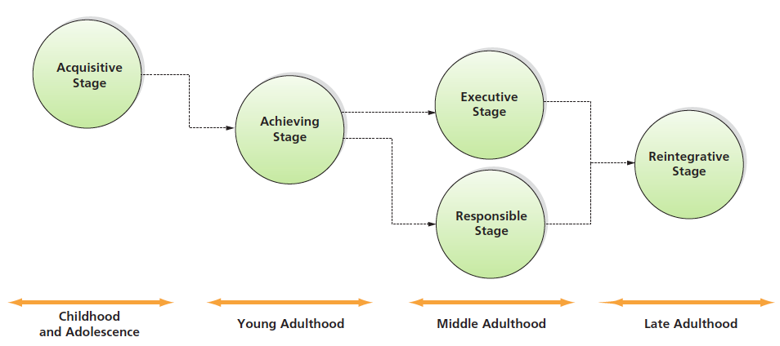
Figure 13-6 Schaie’s Stages of Adult Development
(Source: Based on Schaie, 1977–1978.)
Notes:
Figure 13-6 Schaie’s Stages of Adult Development
(Source: Based on Schaie, 1977–1978.)

Slide 29
Intelligence: What Matters in Early Adulthood?
Triarchic theory of intelligence
  Intelligence is made up of three facets:
    Componential
    Experiential
    Contextual
Notes:
“How do you meet your goals?”-- The way adults answer has a lot to do with their future success according to psychologist Robert Sternberg.
Robert Sternberg, in his TRIARCHIC THEORY OF INTELLIGENCE suggests that intelligence is made up of three major components:
Componential aspects
Experiential components
Contextual factors
Componential intelligence relates to the mental components involved in analyzing data, and in solving problems, especially problems involving rational behavior. (traditional IQ tests focus on this aspect)
Experiential intelligence refers to the relationship between intelligence, people's prior experience, and their ability to cope with new situations.
Contextual intelligence involves the degree of success people demonstrate in facing the demands of their everyday, real-world environments.
Sternberg contends that success in a career necessitates this type of intelligence (contextual), also called PRACTICAL INTELLIGENCE, intelligence that is learned primarily by observing others and modeling their behavior.

Slide 30
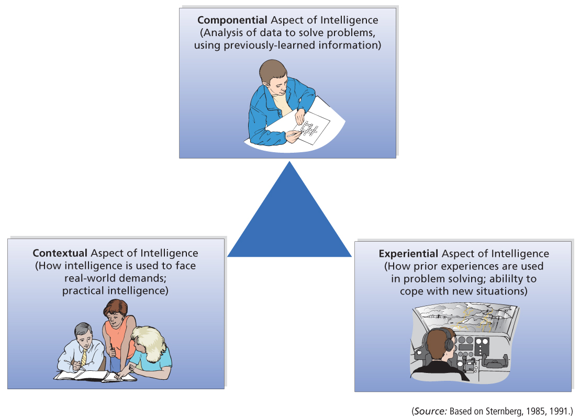
Figure 13-7 Sternberg’s Triarchic Theory of Intelligence
(Source: Based on Sternberg, 1985, 1991.)
Notes:
Figure 13-7 Sternberg’s Triarchic Theory of Intelligence
(Source: Based on Sternberg, 1985, 1991.)

Slide 31
Practical and Emotional Intelligence
Traditional I Q scores
I Q score that most traditional tests produce relates quite well to academic success
I Q seems to be unrelated to other types of achievement, such as career success
Success in a career necessitates other types of intelligence
Practical intelligence
Emotional intelligence

Slide 32
Life Events and Cognitive Development
Major life events may inspire cognitive growth
Think about the world in novel, more complex, sophisticated, and often less rigid ways
Apply postformal thought
Notes:
Major life events, such as marriage, birth of child, starting first job, having child, buying house, may lead to cognitive growth.
The ups and downs of life events may lead young adults to think about world in novel, more complex, sophisticated, and often less rigid ways.
Applying postformal thought (Labouvie-Vief) allows them to deal more effectively with complex social world.

Slide 33
College: Pursuing Higher Education
13.8 Describe who attends college today and how the college population is changing.
13.9 Summarize the difficulties students face as they enter college.
13.10 Describe how gender effects the treatment of college students gender differences in college enrollment and academic performance.
13.11 Summarize why students drop out of college.
Notes:
Explain: Although you may believe that college attendance is commonplace, this is not case at all: Nationwide, high school graduates who enter college are actually in minority.

Slide 34
The Demographics of Higher Education
About 58% of the college population in the U S is white
19% Hispanic
14% African American
7% Asian
Only about 40 percent of those who start, graduate from college in 4 years
Influenced by race and gender variables
Notes:
Nationwide, a minority of high school graduates enter college.
40% of White Americans enter college.
29% of African Americans enter college.
31% of Hispanic high school graduates enter college.
Only about 40% of those who start will graduate from college in 4 years.
½ will eventually finish.
70% of African Americans drop out of college.
Minority students are an increasingly larger proportion of college population.
African American students have increased by 13%.
Hispanic students have increased by 22%.
White students have increased by 6%.
These changes reflect differences in the racial and ethnic composition of U.S. and growing realization that higher education improves economic well-being.
There are now more women than men enrolled in college, and by year 2007, women's enrollment is expected to increase 30% from 1995 compared to an increase of only 13% for men.

Slide 35
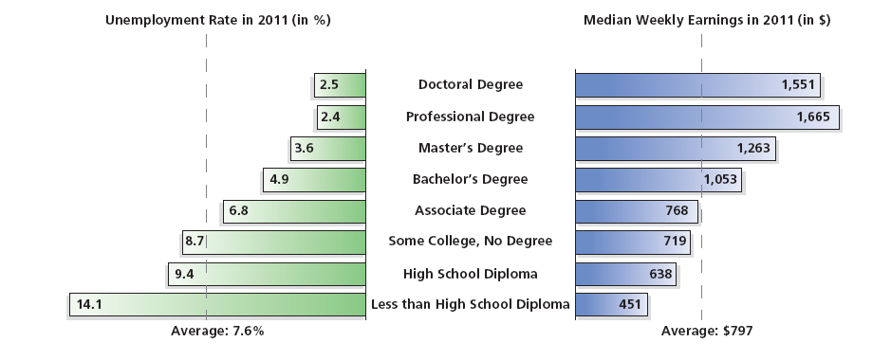
Figure 13-10 Education and Economic Security
Education provides more than knowledge; it is also an important means to attain economic security for both men and women. (Source: U.S. Bureau of Labor Statistics, 2012.)
Notes:
For students who do not attend or complete college, the consequences can be significant.
Higher education is an important way for people to improve their economic well-being.
Just three percent of adults who have a college education live below the poverty line.
Compare that with high-school dropouts: They are 10 times more likely to be living in poverty.
Education provides more than knowledge; it is also an important means to attain economic security for both men and women. (Source: U.S. Census Bureau, 1996.)

Slide 36
Who Goes to College?
More women than men attend college
25 percent of college students today are 25 to 35 years of age or older
Two-third of community college students are older than 22
College degree is becoming increasingly important in obtaining and keeping a job
Notes:
College degree is becoming increasingly important in obtaining a job.
Many employers require and encourage their workers to update their skills.
Although nearly 69 percent of white high school graduates enter college, only 61% of African American and 47% of Hispanic graduates do so. Even more striking, although absolute number of minority students enrolled in college has increased, the overall proportion of the minority population that does enter college has decreased over the past decade—a decline that most education experts attribute to changes in the availability of financial aid.

Slide 37
The Changing College Student: Never Too Late to Go to College?
Adults return to college for several reasons:
To understand their own aging
To keep up with rapid technological and cultural advances
To combat obsolescence on the job
To acquire new vocational skills
To broaden their intellectual skills

Slide 38
College Adjustment: Reacting to the Demands of College Life
First-year adjustment reaction
Particularly affects unusually successful students in high school
Passes for most students, as friends are made and integration into college life occurs
Serious psychological consequences for a few people
Notes:
First-year adjustment reaction is a cluster of psychological symptoms, including loneliness, anxiety, and depression, relating to the college experience.

Slide 39
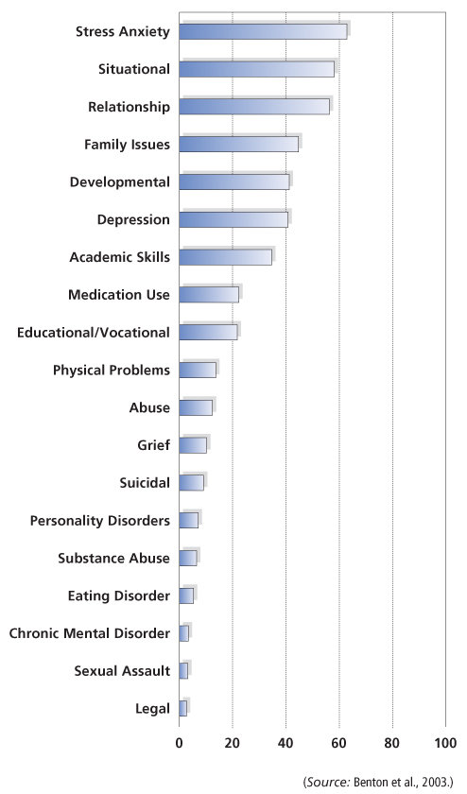
Figure 13-11 College Problems
The difficulties most frequently reported by college students visiting a campus counseling center. (Source: Benton et al., 2003.)
Notes:
Surveys find that almost half of college students report having at least one significant psychological issue.
Other research finds that more than 40 percent of students who visited a college counseling center, reported being depressed.
These figures include only those students who sought help from the counseling center and not those that did not seek treatment.
Figures are not representative of the entire college population.

Slide 40
Gender and College Performance
Prejudice and discrimination
Hostile sexism
Benevolent sexism
Differences exist in gender distribution in classes and attrition rates
Notes:
Prejudice and discrimination directed at women is still a fact of college life.
Hostile sexism (overtly harmful treatment).
Benevolent sexism (a form of sexism in which women are placed in stereotyped & restrictive roles that may appear positive.
Complimenting a student on appearance.
Offering an easier research project so a student won't have to work so hard.
Message may be that the woman is not taken seriously, and competence is undermined. Differences exist in gender distribution in classes and attrition rates.
Classes in engineering, the physical sciences, and mathematics tend to have more men than women.
Women earn just 22% of the bachelor degrees in science and 13% of the doctorates.
Women are more likely to drop out of math, engineering, and physical science classes.

Slide 41
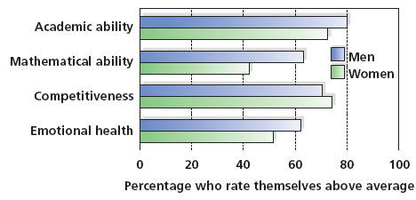
Figure 13-12 The Great Gender Divide
During their first year of college, men, compared to women, are more apt to view themselves as above average on several spheres relevant to academic success. What is the root of this difference?
(Source: The American Freshman: National Norms for Fall, 1990; Astin, Korn, & Berz, 1989. Higher Education Research Institute, U C L A.)
Notes:
(Source: The American Freshman: National Norms for Fall, 1990; Astin, Korn, & Berz, 1989. Higher Education Research Institute, UCLA.)

Slide 42
Dropping Out of College
Reasons
Marriage, children, or death of family member
Academic difficulties
Financial difficulties
Time off to mature
Notes:
Half of all students drop out of college
The FIRST-YEAR ADJUSTMENT REACTION is a group of psychological symptoms relating to the college experience.
Most likely to occur among students who were especially successful academically or socially in high school (sudden change in status often causes distress)
Surveys show that almost half of all college students have a least one significant psychological issue.
Marriage, children, or death of parent requires students to drop out
Academic difficulties
College is expensive
Some students need time off to mature

Slide 43

Copyright

